Slide 1
Business Intelligence Concepts, Tools, and Applications
Week 3: Data Visualization and Dashboard Design
Lesson 2: Data Visualization Guidelines and Pitfalls

Slide 2
Data Visualizations Guidelines and Pitfalls
Learning Objectives
Identify best practices for designing data visualizations in preparation for completing the data visualization exercise.

Slide 3
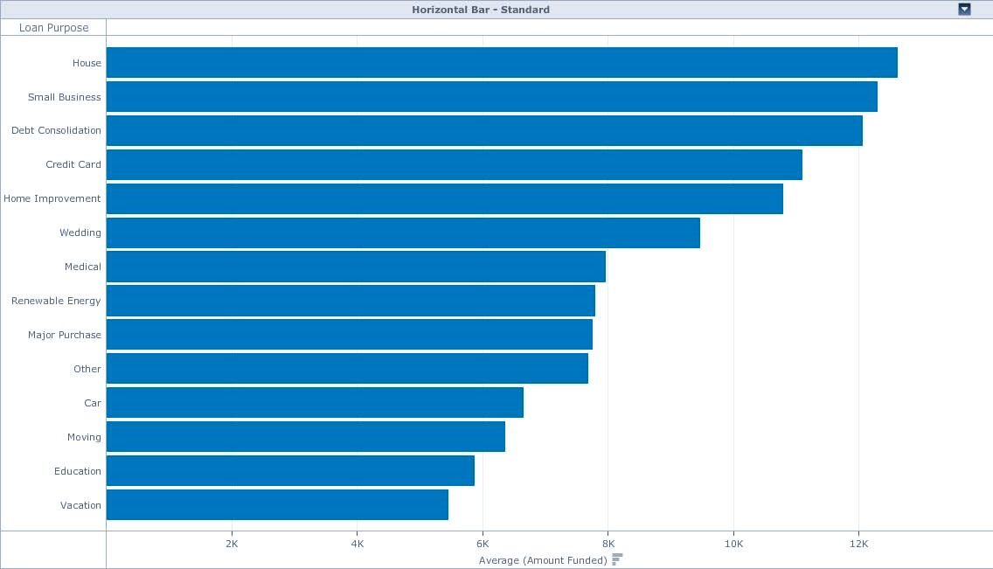
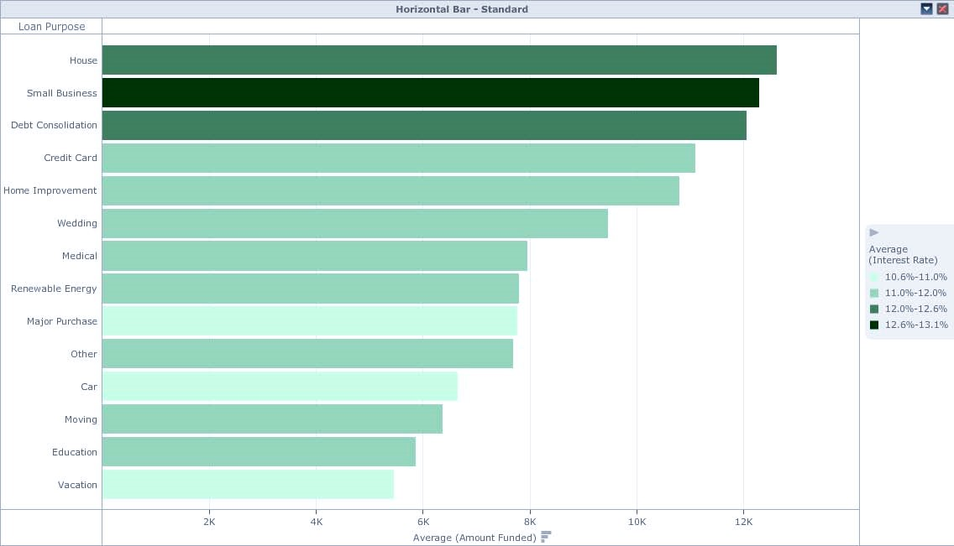
Visualizations Attribute (nominal) and Metric
Comparative Analysis -Bar Chart
Sorted
Comparative analysis- Bar Chart
with Color to highlight Metric Patterns
Adapted from Best Practices in Data Visualization, by Vihao Pham 2014
Notes:
Adapted From Best Practices in Data Visualization, by Vihao Pham 2014
Bar charts
Think about bar width.
Avoid using distracting fills.
Avoid using unnecessary effects such as 3D.
Think about the order of the bars.

Slide 4
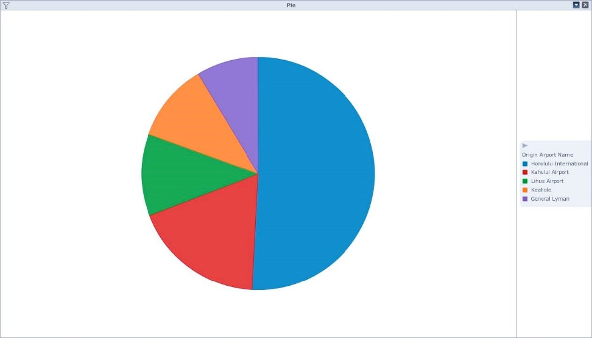
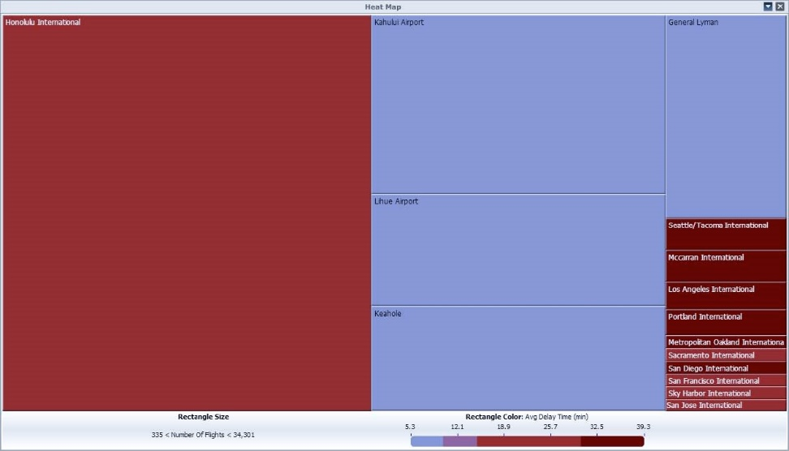
Visualizations Attribute(nominal) and Metric
Contribution analysis-few elements- Pie Chart
Contribution Analysis- Many Elements- Heat Map
Adapted from Best Practices in Data Visualization, by Vihao Pham 2014
Notes:
From Best Practices in Data Visualization, by Vihao Pham 2014

Slide 5
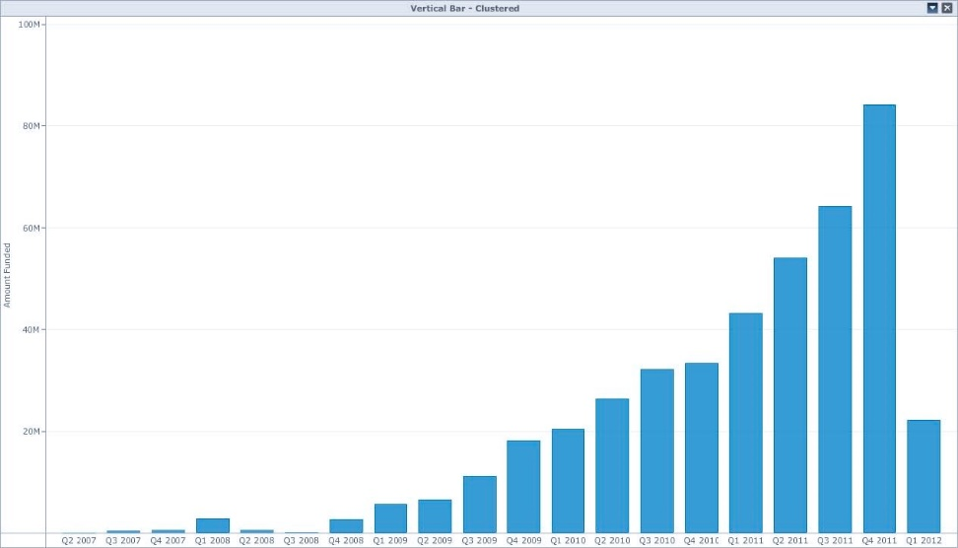
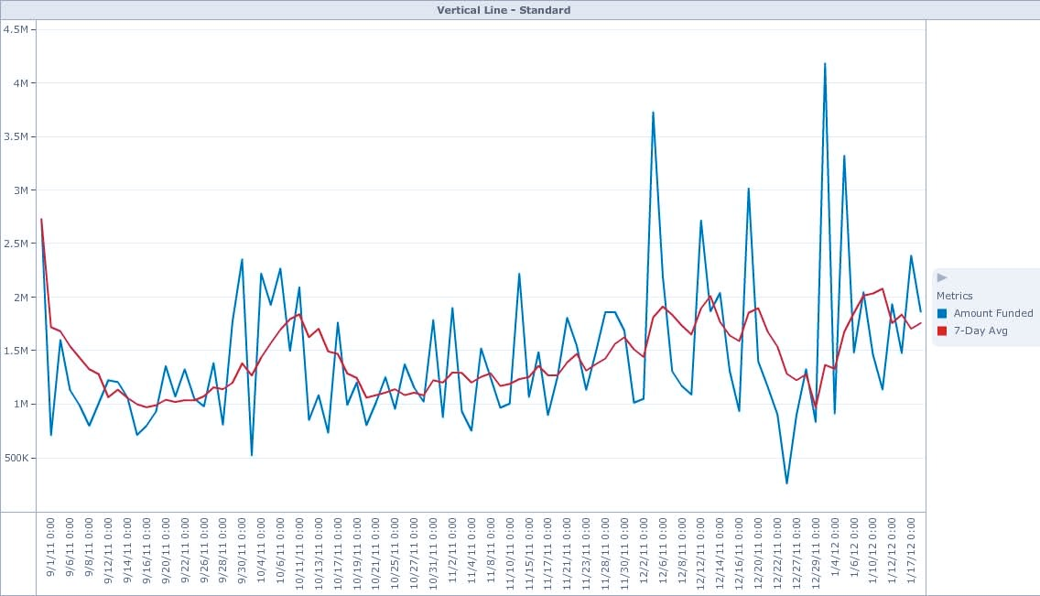
Visualizations Attribute (ordinal) and Metric
Time-series analysis- Few elements- Column Chart
Time-series Analysis- Many Elements- Line chart
Adapted From Best Practices in Data Visualization, by Vihao Pham 2014
Notes:
From Best Practices in Data Visualization, by Vihao Pham 2014
Line Charts
Avoid misinterpreting the trends.
Think about line thickness.
Avoid using too many different line styles.
Avoid including too many lines altogether.
Label each line directly.

Slide 6
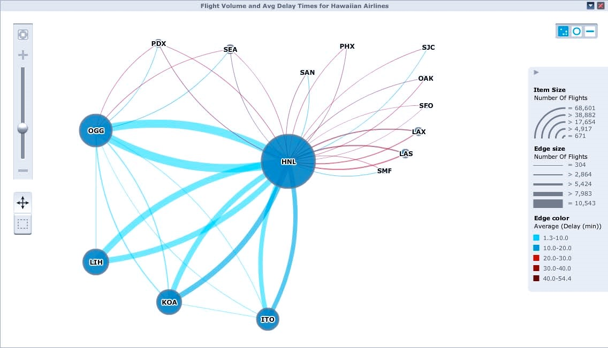
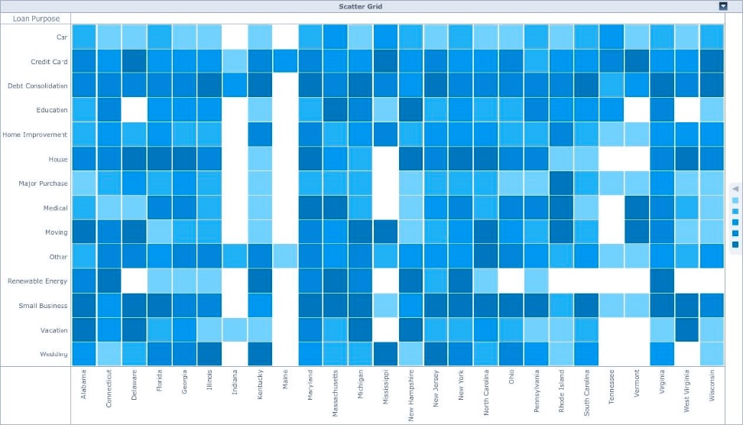
Visualizations Attribute (Nominal) and Attribute (Nominal)
Market Basket or Network Analysis- Network Visualization
Market Basket or Network Analysis-
Avoid Scatter Grid- Implied ordinality
Adapted from Best Practices in Data Visualization, by Vihao Pham 2014
Notes:
From Best Practices in Data Visualization, by Vihao Pham 2014

Slide 7
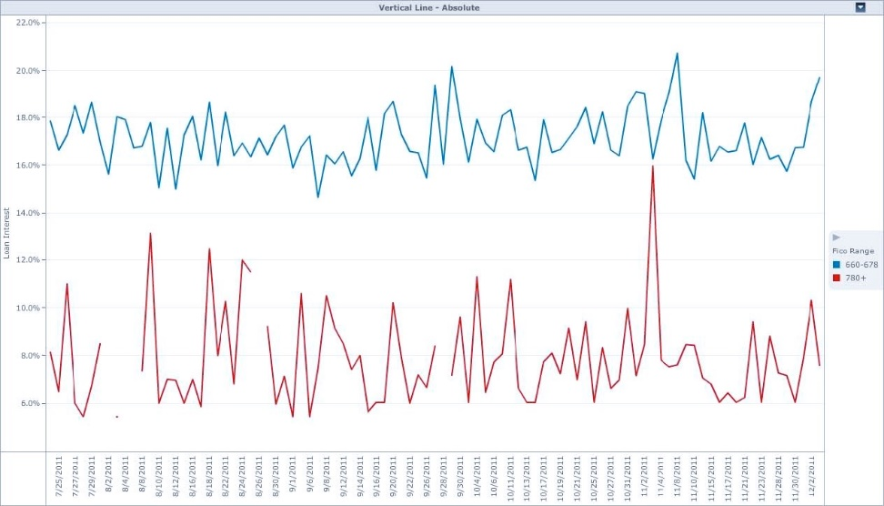
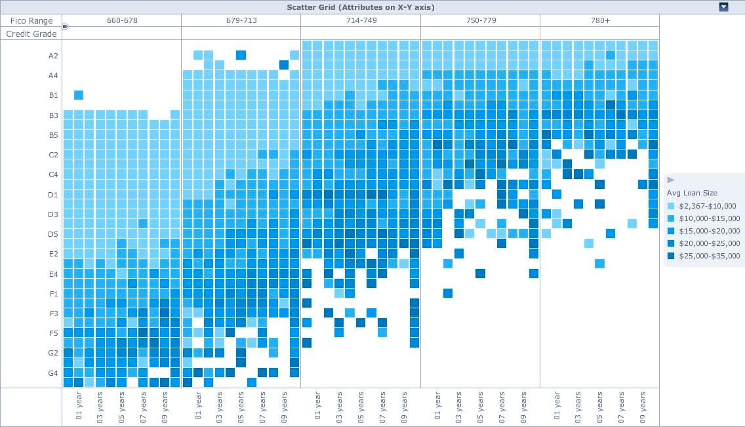
Visualizations Attribute (nominal) and Attribute (ordinal)
Time-series Comparative Analysis- Line Chart with Break-by
Cluster or Heat map Analysis Scatter Grid
Adapted from Best Practices in Data Visualization, by Vihao Pham 2014
Notes:
From Best Practices in Data Visualization, by Vihao Pham 2014

Slide 8
Appropriate Visualizations
 | Metric | Attribute (Nominal) | Attribute (Ordinal)
Attribute (Nominal) | Bar Heatmap | Network | Line w/ Break-By Bar w/ Break-By
Attribute (Ordinal) | Column Line |  | Scatter Grid
Metric | Scatter/Bubble
Adopted from Best Practices in Data Visualization, by Vihao Pham 2014
Notes:
From Best Practices in Data Visualization, by Vihao Pham 2014

Slide 9
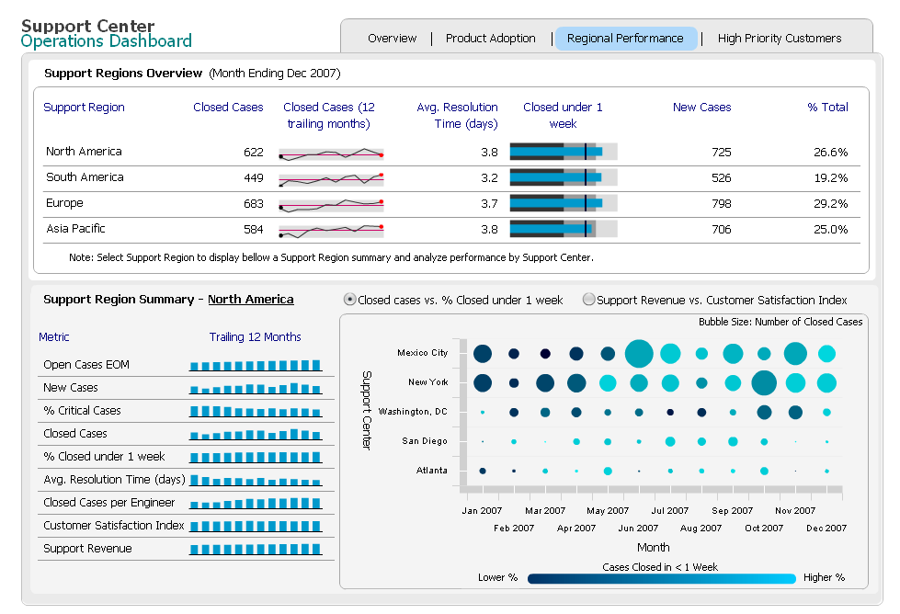
A Sparkline, Bullet Chart, Column Chart and Bubble Grid Are Used to Analyze Activities in a Customer Support Center
Notes:
Do not demo the dashboard, just use this screenshot to explain the visualizations included on it.
In a given dashboard you may need to include various types of data visualizations

Slide 10
General Rules for Charts
Think about which increments are best to use in charts.
Avoid combining unrelated charts into one.
Consider the importance of direction when presenting data.
Avoid cramming too much information into each chart.
Make sure that any data labels or data legends are legible.
Think about the order and direction of the slices in a pie chart.
Avoid using too many effects to differentiate each slice.
Think about the size of sparklines.
Ensure they are placed in relevant sections.
Source: Adopted from Free E-Book: How to Create Compelling Business Dashboards: Everything you need to know to design best-practice dashboards and data visualizations. Matillion Business Intelligence.
Notes:
Source: Free E-Book: How to Create Compelling Business Dashboards: Everything you need to know to design best-practice dashboards and data visualizations. Matillion Business Intelligence.

Slide 11
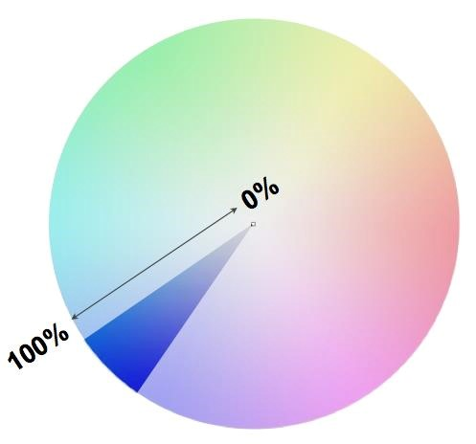

Visualization Considerations Use Color Saturation Correctly
More Saturation: Greater Values
Less Saturation: Small Values
Adapted from Best Practices in Data Visualization, by Vihao Pham 2014
Notes:
From Best Practices in Data Visualization, by Vihao Pham 2014

Slide 12
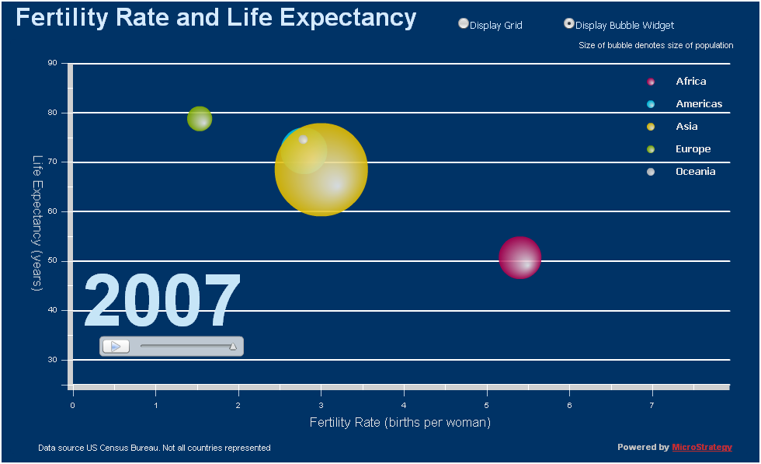
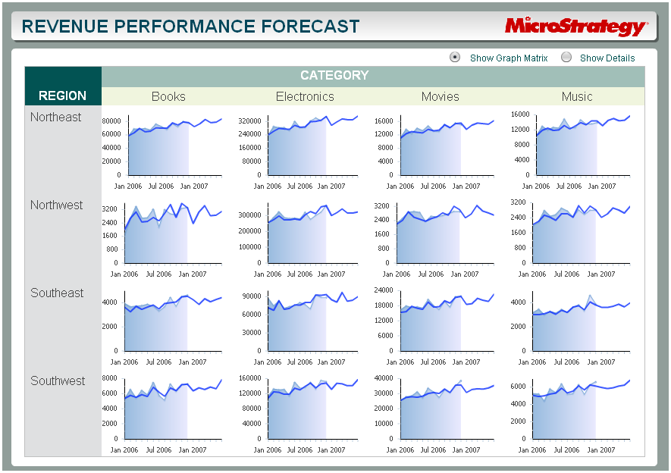
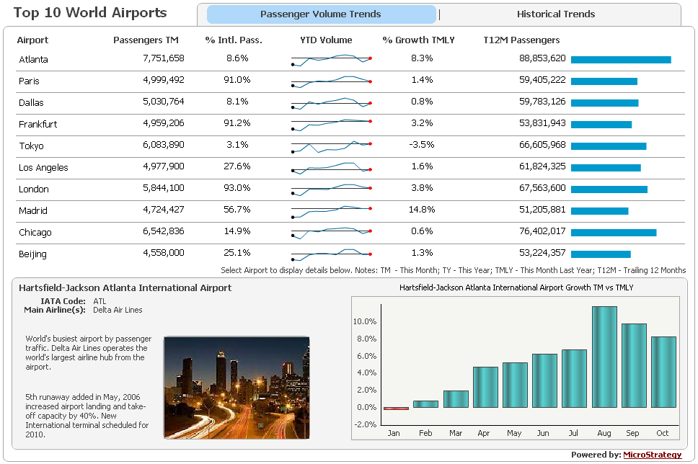
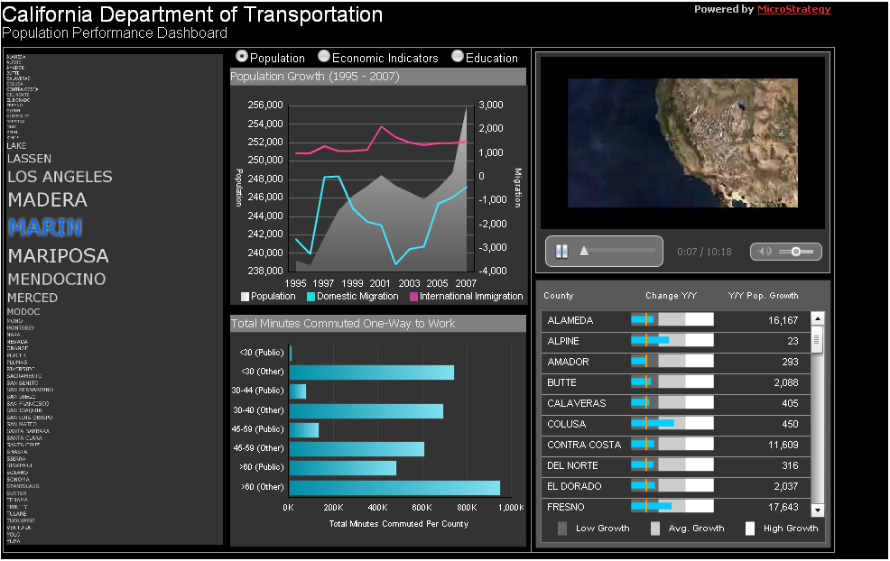
Hands-on Exercise #3 Offline/Standalone Dashboards with Advanced Visualizations
Dynamic Dashboards Help Business People Make Better Decisions, Faster
Notes:
Now, we’re going to have you quickly access some dashboards and experience them yourselves.
Exercise format:
As the instructor, do one of the dashboards as a follow-along exercise. Fertility or California dashboards are good examples, though the Region and Category Analysis dashboard is both interesting and challenging to attendees given the heatmap features and controls.
The attendees will then select one dashboard to conduct their analysis. You can pre-select it for them, if you wish to do so.
The rest of the dashboards (except OECD) are available on the Dashboard Library, from the MicroStrategy corporate website.
The exercise script includes a couple of pages briefly introducing each dashboard, so they can select which one to work with depending on their industry or visualization interest. Then, the next are one-pager description of the dashboard, the data and the visualizations within it, and the questions they should search answers for. At the end of the exercise, the Answer Sheet is provided, together with how to navigate the data in order to find the answers requested.

